Slide 1
Neural Networks

Slide 2
What we will cover?
Neurons or Perceptrons
Activation Functions
Cost Function
Backpropogation
Gradient Descent

Slide 3
Neurons / Perceptron
Very important part of brain through which the signals are transmitted.
Artificial Neural Network is based on Neural Biological Systems.
ANN is a software based approach to replicate the biological neurons.
An artificial neuron is a connection point in an artificial neural network.
Neuron can process input and forward output to other nodes in the network.

Slide 4
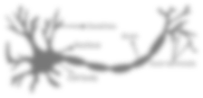
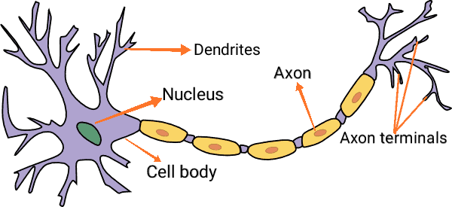
Biological Neurons

Slide 5
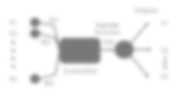
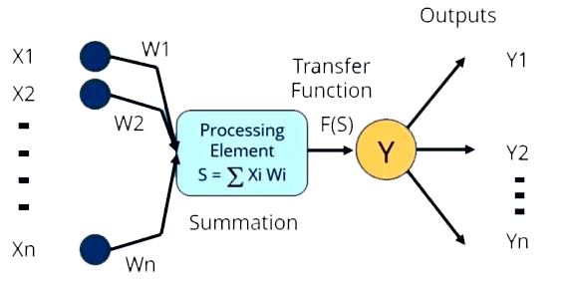

Artificial Neurons
Bias

Slide 6
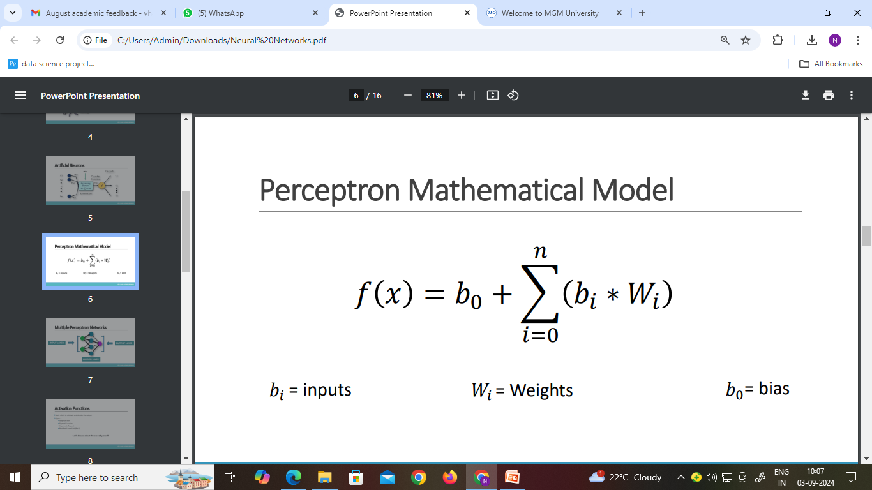
Perceptron Mathematical Model
𝑏_{𝑖} = inputs
𝑊_{𝑖} = Weights
𝑏₀= bias

Slide 7

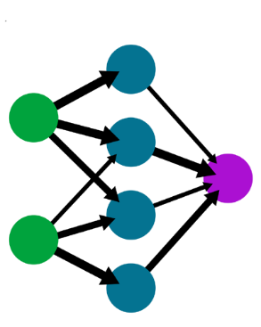
Multiple Perceptron Networks
INPUT LAYER
OUTPUT LAYER
HIDDEN LAYER

Slide 8
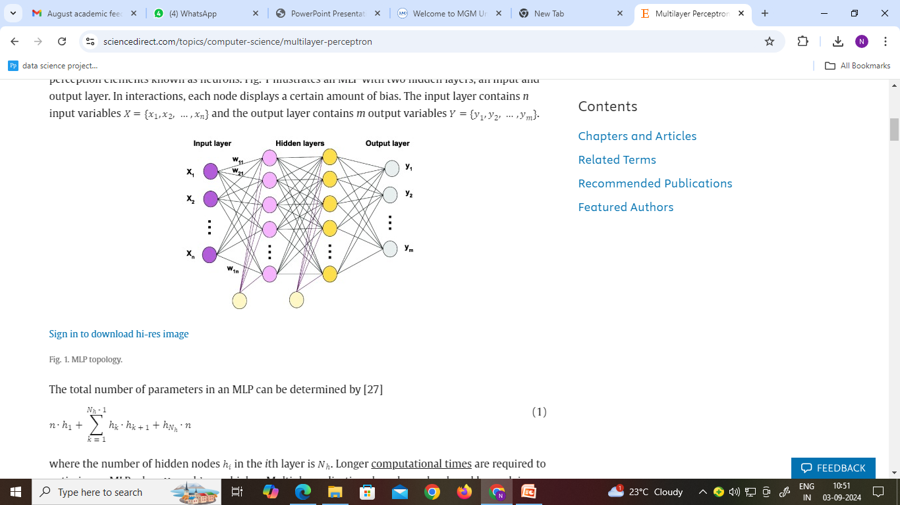
Multi-Layered Perceptron Networks
For Non-Linear patterns, use (Multi-Layered Perceptron ) MLP
Every Neuron is connected with every other neuron in the forward layer.
This is called as Dense Layer or Fully Connected Layer.
Except input, other neurons has 2 parts as Integration(Summation) & Activation function.
We can have as many as Hidden Layers

Slide 9
MLP
Output Type | No. Of neurons in output Layer | Loss/Cost Function
Continuous | Single | MSE
Discrete (2 Categories) | One or Two | Binary Cross Entropy
Discrete (>2 Categories) | As many as output categories | Categorical Cross Entropy

Slide 10
Activation Functions
Main role is to calculate and decides the output.
Types –
Step Function
Sigmoid Function
Rectified Linear Unit (ReLU)
Softmax
Let’s discuss about these one by one !!

Slide 11

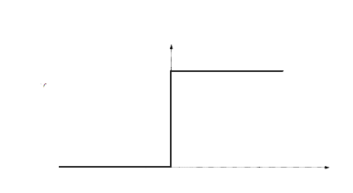
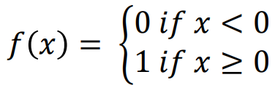
Step Function
1
0

Slide 12
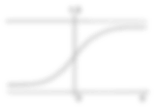
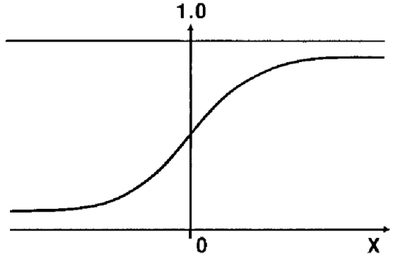
Sigmoid Function
1
𝑓 𝑥 =
_{1 + 𝑒}−(𝑥)

Slide 13
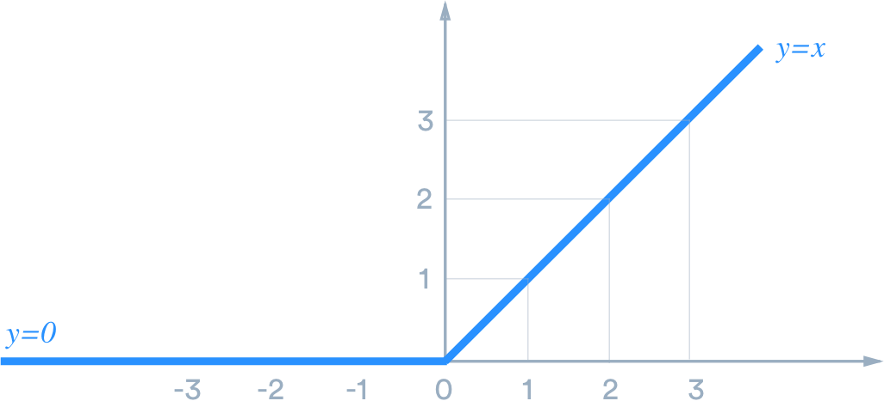
Rectified Linear Unit (ReLU) Function
ReLU is a non-linear activation function used for deep neural networks in machine learning.
Mostly Used in hidden layer
𝑓 𝑥
= max (0,x)

Slide 14
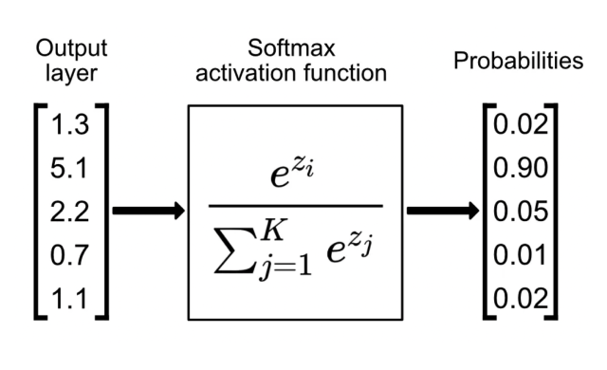
Softmax Activation Function
The Softmax Function is used in multi-class classification problems.
Its primary role is to transform a vector of arbitrary values into a vector of probabilities.
The sum of these probabilities is one.

Slide 15
Activation Function Summary
Output Type | Activation Function
Continuous | Identity/Linear
Discrete (2 Categories) | Sigmoid
Discrete (>2 Categories) | Softmax

Slide 16
Cost Function
It calculates difference between the actual and predicted values, i.e. it calculates the error.
y = actual values
a = predicted values
σ (𝑦 − 𝑎)²
𝐶 =
𝑛
It has one drawback as it slows down the learning of neural network, So in this case we use
“Cross Entropy”

Slide 17
Cross Entropy
It reduces the cost function and increases the learning of neural network.
𝑛
∗ ෍(𝑦 ∗ ln 𝑎
𝑖=0
−1
𝐶 =
+ (1 − 𝑦) ∗ ln(1 − 𝑎))
𝑛
y = actual values
a = predicted values

Slide 18
Back-Propagation
It is simply a revision of weights.
In this using Feed Forward Network, weights are changed till we get the least cost function
(error)

Slide 19
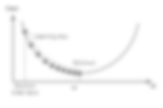
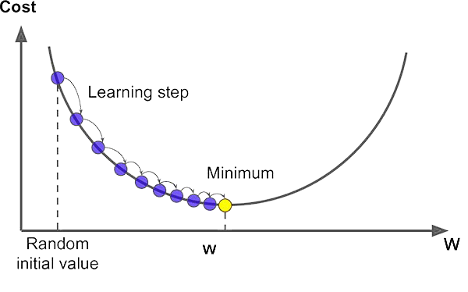
Gradient Descent
It is an optimization algorithm for finding the minimum value of a function to reduce cost.

Slide 20
Gradient Descent Algorithm
Gradient descent is an optimization algorithm which is used to train machine learning models and neural networks.
It trains machine learning models by minimizing errors between predicted and actual results.
Types of Gradient Descent:
Batch Gradient Descent
Stochastic Gradient Descent
Mini-batch Gradient Descent

Slide 21
Batch Gradient Descent
Batch Gradient Descent : - It sums the error for each point in a training set, updating the model only after all training examples have been evaluated. This process referred to as a training epoch.
If you update the weight 1 time, it is called as 1 iteration.
Traverse all samples forward and backward is called as 1 epoch(1 iteration,1 epoch)
Batching provides computation efficiency.
It requires long processing time for large training datasets as it still needs to store all of the data into memory.

Slide 22
Stochastic Gradient Descent
Stochastic Gradient Descent : - Stochastic gradient descent (SGD) runs a training epoch for each example within the dataset and it updates each training example's parameters one at a time.
Assume 1000 observations in dataset ; i.e. 1000 iteration,1 epoch.
Since you only need to hold one training example, they are easier to store in memory.
Its frequent updates can result in noisy gradients.

Slide 23
Mini-Batch Gradient Descent
Mini-Batch Gradient Descent : - It combines concepts from both batch gradient descent and stochastic gradient descent.
It splits the training dataset into small batch sizes and performs updates on each of those batches.
This approach strikes a balance between the computational efficiency of batch gradient descent and the speed of stochastic gradient descent.
E.g. Assume 1000 Dataset & Batch size =100
10 iteration,1 epoch.

Slide 24
Quiz
In a fully connected layer, a single node's output depends on _______________.
1. The sum of weighted connections
2. The sum of inputs
3. The weighted sum of inputs
4. The product of inputs
What is the basic building block of an artificial neural network (ANN)?
Neuron
Weight
Activation Function
Layer

Slide 25


Slide 26
The term "deep" in Deep Learning refers to ANNs with:
Large number of Neuron
High number of epoch
A large number of layers
A learning rate

Slide 27
Which activation function is commonly used for binary classification problems?
Sigmoid
ReLU
Tanh
Softmax

Slide 28
Overfitting in an ANN occurs when?
The model performs well on training data but poorly on unseen data
The model has too few layers
The model is too simple
Which ANN architecture connects each neuron from one layer to every neuron in the subsequent layer?

Slide 29
Which ANN architecture connects each neuron from one layer to every neuron in the subsequent layer?
Multilayer Perceptron
Recurrent Neural Network
Convolutional Neural Network

Slide 30
Cross Entropy

